Slide 1
Introduction to ITWS Class Agenda for Jan 29
How to Prepare and Write a Business Case
First Case Feb 19
Communications and Networks
Global Wide Area Network Exercise

Slide 2
Business Case Analysis
Read the Case.
The Case is a “story” about a relevant IT company or situation intended to provide experiential learning about the topics in this course.
Read the Case Questions.
Re-read the case with the questions in mind.
Research material about the company on its website, www.reuters.com/finance, www.finance.yahoo.com, www.google.com/finance, and other current media.
Think about the Case questions. You are encouraged to meet in groups to discuss the case questions, but your written submission must be your own.
Be prepared to discuss and answer all the Case Questions during class. You may be called upon without raising your hand.
Write and submit the answer prior to the beginning of class to the one Case written question that is to be submitted on LMS individually.

Slide 3
How to Write the Business Case Answer
Do not simply summarize the Case.
Answer the Specific Question.
The length should be 1-2 pages, single spaced, 12 point font with normal borders.
Use qualitative arguments to support the answer.
Use quantitative arguments to support the answer.
Use concepts and data from the Case.
Use concepts and data from online research (e.g. companies website, financial websites, online research).
Bring in personal knowledge.
Words without numbers are fair at best.
Numbers without words are fair at best.
Use good quality English language: style, rhetoric, grammar, spelling, references.
Show insight.

Slide 4
First Business Case
Prepare to answer all of the Case questions in class on February 19.
Submit the answer to the written case question prior to the beginning of class before 12 pm on Monday February 19
Since we are discussing the answers to the Case in class, any submission after class start will get a maximum of 70% of the potential grade.
Discuss with classmates, but write and submit your written answer individually.

Slide 5
Current events in technology

Slide 6
Introduction to ITWS is:
Introduction to Technology (applied Computer Science and applied Web Science)
Protocols
Programming
Web design
Database
Introduction to Applications
Communication and Networking
Social Networks
Enterprise Apps (ERP, SCM, CRM)
Web and Mobile Consumer Apps
Healthcare and other Services

Slide 7
ITWS Concentrations
Concentrations | Concentrations
Arts | Information Security
Civil Engineering | Machine and Computational Learning
Communication | Management Information Systems
Communication and Networks | Mechanical/Aeronautical Engineering
Computer Hardware | Medicine
Economics | Pre-Law
Electronic Commerce | Psychology
Entrepreneurship | Science and Technology Studies
Finance | Science Informatics
Industrial Engineering | Web Technologies

Slide 8
Concentrations associated with Networks, Networking and the Internet
Concentrations | Concentrations
Arts | Information Security
Civil Engineering | Machine and Computational Learning
Communication | Management Information Systems
Communication and Networks | Mechanical/Aeronautical Engineering
Computer Hardware | Medicine
Economics | Pre-Law
Electronic Commerce | Psychology
Entrepreneurship | Science and Technology Studies
Finance | Science Informatics
Industrial Engineering | Web Technologies

Slide 9
Networking and Communications Applications
What are some types and specific examples of networking and communications applications?

Slide 10
Networking and Communications Applications
What are some technologies used in networking and communications applications?

Slide 11
Network Models
OSI 7-Layer reference model
Internet Protocol Suite
(also known as TCP/IP)
Protocol Examples
7
Application
Application
HTTP, FTP, IMAP, POP, SSH...
6
Presentation
5
Session
4
Transport
Transport
TCP, UDP...
3
Network
Internet
IP (v4, v6)...
2
Data Link
Link
Ethernet, IEEE 802.11, USB, DSL...
NIC, Category 5 cables, Microwave
1
Physical
RFC 1122
http://tools.ietf.org/html/rfc1122

Slide 12
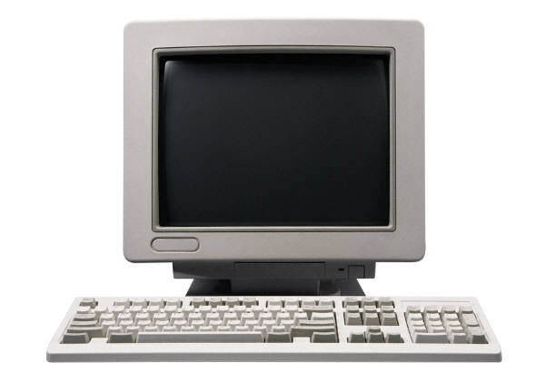

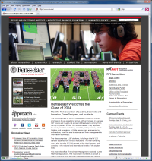
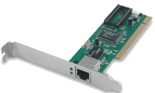
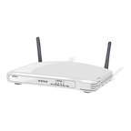
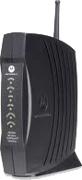
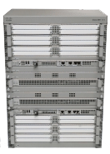
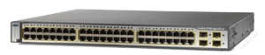
Web Browsing
Revisited
Application
client
server
Application
apache web server
HTTP GET Request
HTTP Response
Transport
Transport
:80
TCP
ESTABLISHED
ESTABLISHED
TCP
Internet
Internet
IP
IP
Link
Link
MAC
MAC

Slide 13
Networking and Communications Applications
What is the value of Communications Network?

Slide 14
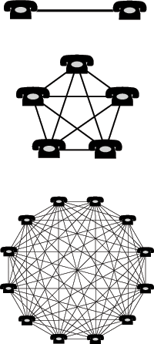
Networking and Communications Applications
Metcalfe's law states that the value of a telecommunications network is proportional to the square of the number of connected users of the system (n²). First formulated in this form by George Gilder in 1993,^{[1]} and attributed to Robert Metcalfe.*
* http://en.wikipedia.org/wiki/File:Network_effect.png

Slide 15
Networking and Communications Applications
Metcalfe's law
Value of Network is proportional to the Number of Users Squared or the Value of the Network increases exponentially with the Number of Users
Cost of a Network is proportional to the Number of Users or the Cost of the Network increases arithmetically with the Number of Users

Slide 16
Introduction to ITWS is:
Introduction to Technology (applied Computer Science and applied Web Science)
Protocols
Programming
Web design
Database
Introduction to Applications
Communication and Networking
Social Networks
Enterprise Apps (ERP, SCM, CRM)
Web and Mobile Consumer Apps
Healthcare and other Services

Slide 17
Communications
Telecommunication is the transmission of messages, over significant distances, for the purpose of communication.
In the modern age of electricity and electronics, telecommunications has typically involved the use of electric means such as the telegraph, the telephone, and the teletype, the use of microwave communications, the use of fiber optics and their associated electronics, and/or the use of the Internet.

Slide 18
Communications
World's effective capacity to exchange information through two-way telecommunication networks grew from 281 petabytes of information in 1986 to 65 exabytes in 2007.^{[8]} This is the informational equivalent of two newspaper pages per person per day in 1986, and six entire newspapers per person per day by 2007.^{[9]}
The global telecommunications industry was about a $4.7 trillion sector in 2012.^{[10][11]} The service revenue of the global telecommunications industry was estimated to be $1.5 trillion in 2010, corresponding to 2.4% of the world’s gross domestic product (GDP).^{[10]} World’s GDP was $70 trillion in 2012

Slide 19
Scale of Communications and Networks
Multiples of bytes
Decimal
Value | Metric
1000 | kB | kilobyte
1000² | MB | megabyte
1000³ | GB | gigabyte
1000⁴ | TB | terabyte
1000⁵ | PB | petabyte
1000⁶ | EB | exabyte
1000⁷ | ZB | zettabyte
1000⁸ | YB | yottabyte
Binary
Value | JEDEC |  | IEC
1024 | KB | Kilobyte | KiB | kibibyte
1024² | MB | Megabyte | MiB | mebibyte
1024³ | GB | Gigabyte | GiB | gibibyte
1024⁴ | TB | Terabyte | TiB | tebibyte
1024⁵ |  |  | PiB | pebibyte
1024⁶ |  |  | EiB | exbibyte
1024⁷ |  |  | ZiB | zebibyte
1024⁸ |  |  | YiB | yobibyte

Slide 20

Communications
~2003 Visualization from the Opte Project of the various routes through a portion of the Internet
http://en.wikipedia.org/wiki/File:Internet_map_1024.jpg
Notes:
http://www.opte.org/

Slide 21
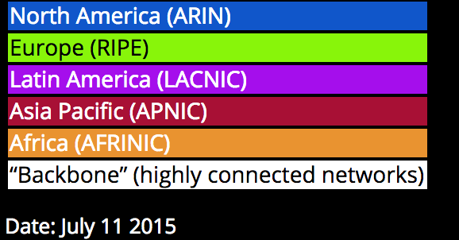
Communications
2015 Visualization from the Opte Project of the various routes through a portion of the Internet
http://www.opte.org/the-internet/
Notes:
http://www.opte.org/

Slide 22
Communications
Basic elements
A basic telecommunication system consists of three primary units that are always present in some form:
A transmitter that takes information and converts it to a signal.
A transmission medium, also called the "physical channel" that carries the signal. An example of this is the "free space channel“.
A receiver that takes the signal from the channel and converts it back into usable information.

Slide 23
Communications
Telecommunication over telephone lines is called point-to-point communication because it is between one transmitter and one receiver. Telecommunication through radio broadcasts is called broadcast communication because it is between one powerful transmitter and numerous low-power but sensitive radio receivers.^{[22]}

Slide 24
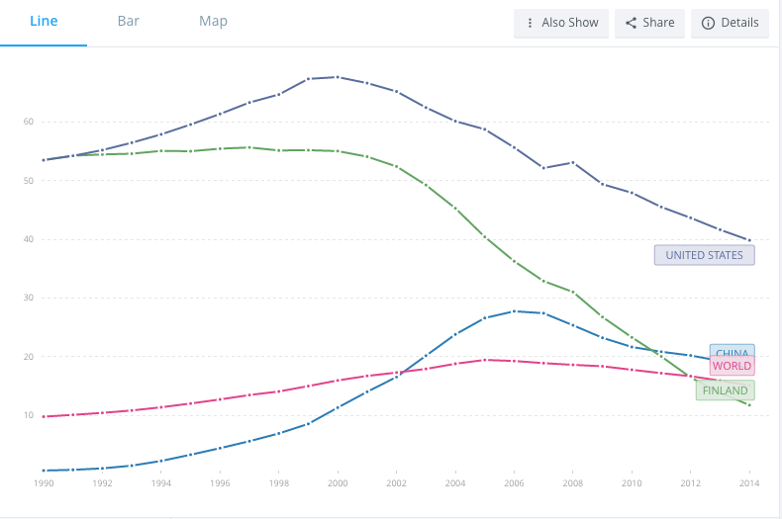
Telephone Lines/100 people Data from Worldbank.org
Notes:
https://data.worldbank.org/indicator/IT.MLT.MAIN.P2?view=chart
Internet : https://data.worldbank.org/indicator/IT.NET.USER.ZS
Mobile Cellular subscriptions : https://data.worldbank.org/indicator/IT.CEL.SETS

Slide 25
Communication
Communications networks
A communications network is a collection of transmitters, receivers, and communications channels that send messages to one another. Some digital communications networks contain one or more routers that work together to transmit information to the correct user. An analog communications network consists of one or more switches that establish a connection between two or more users.

Slide 26
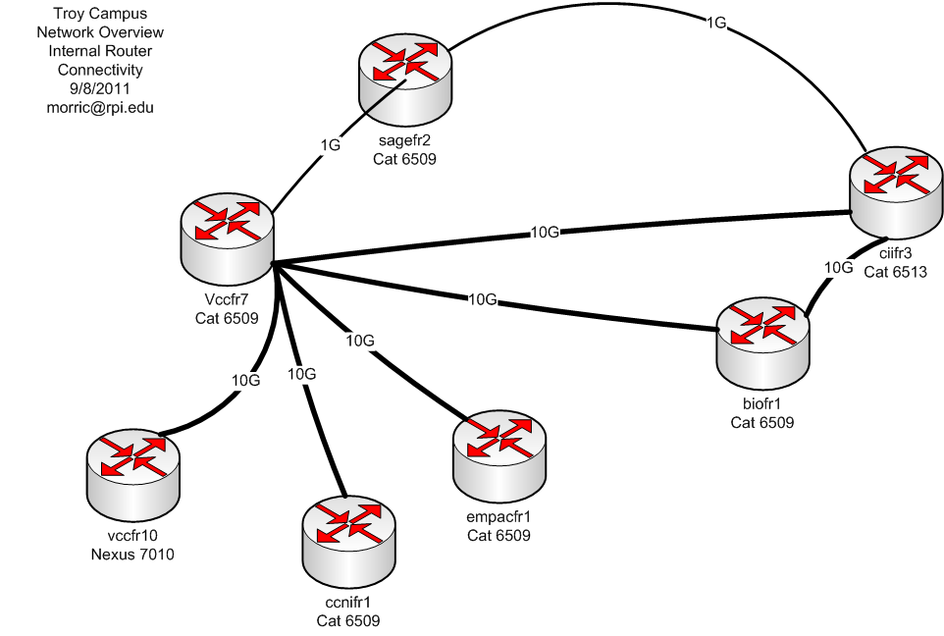
RPI Campus Router Backbone

Slide 27
Communications
Communication channels
The term "channel" has two different meanings. In one meaning, a channel is the physical medium that carries a signal between the transmitter and the receiver. Examples of this include the atmosphere for sound communications, glass optical fibers for some kinds of optical communications, coaxial cables for communications by way of the voltages and electric currents in them, and free space for communications using visible light, infrared waves, ultraviolet light, and radio waves.

Slide 28
Communications
Another way of dividing a communications medium into channels is to allocate each sender a recurring segment of time (a "time slot", for example, 20 milliseconds out of each second), and to allow each sender to send messages only within its own time slot. This method of dividing the medium into communication channels is called "time-division multiplexing" (TDM), and is used in optical fiber communication.^{[24][25]}

Slide 29
Time Division Multiplexing and Dense Wavelength Division Multiplexing
YouTube Video explaining Pulse Code Modulation and Time Division Multiplexing http://www.youtube.com/watch?v=NHZrqRCr-3c
YouTube Video explaining Dense Wavelength Division Multiplexing http://www.youtube.com/watch?v=QBiSYQsGTLA

Slide 30
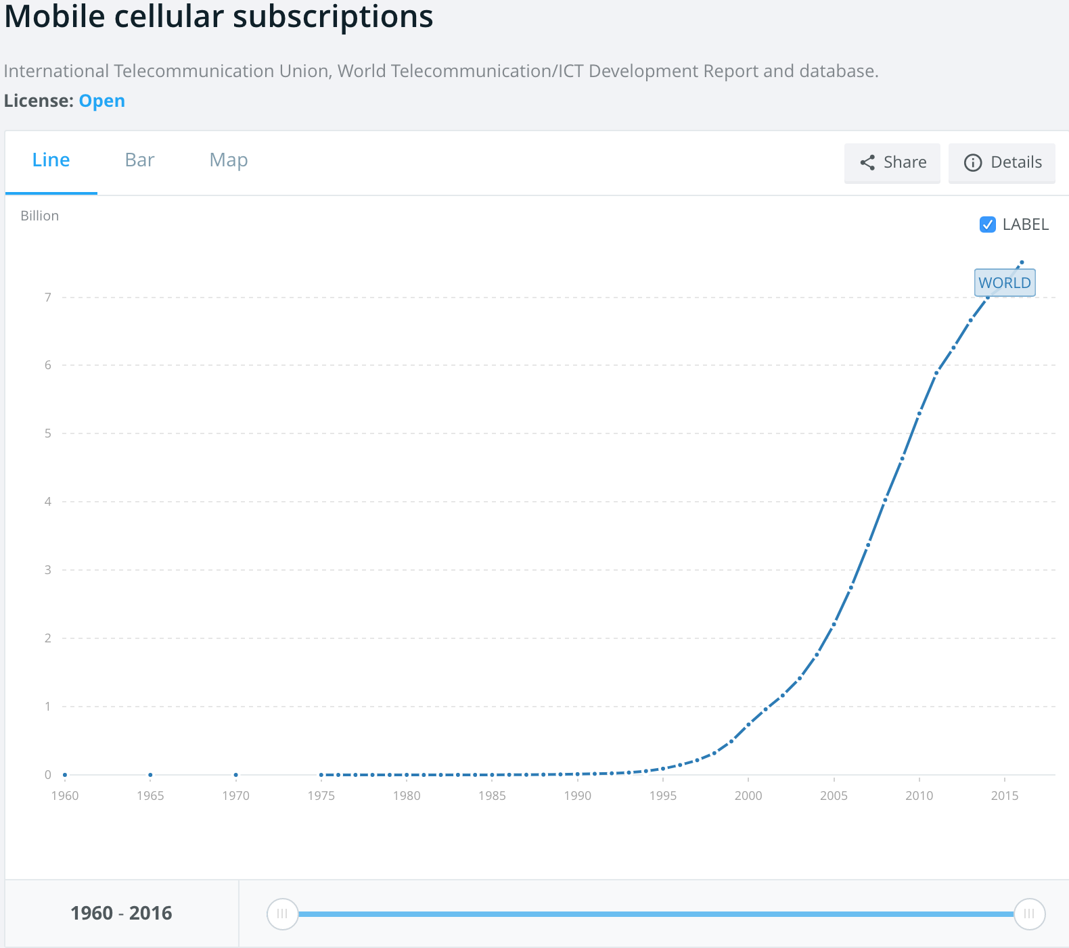
Mobile/Cellular Users Data from Worldbank.org
Notes:
https://data.worldbank.org/indicator/IT.CEL.SETS

Slide 31
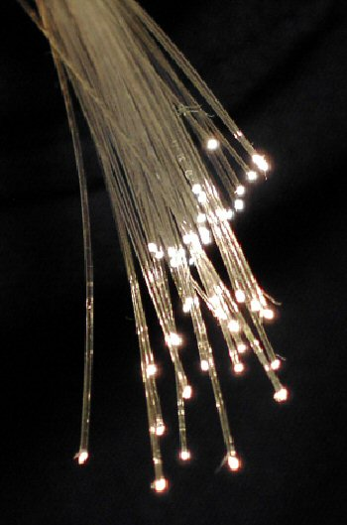
Communications
The 1990s saw the widespread adoption of systems based on optic fibres. The benefit of communicating with optic fibers is that they offer a drastic increase in data capacity. This increase in data capacity is due to several factors: First, optic fibres are physically much smaller than competing technologies. Second, they do not suffer from crosstalk which means several hundred of them can be easily bundled together in a single cable.^{[50]} Lastly, improvements in multiplexing have led to an exponential growth in the data capacity of a single fibre.^{[51][52]}

Slide 32
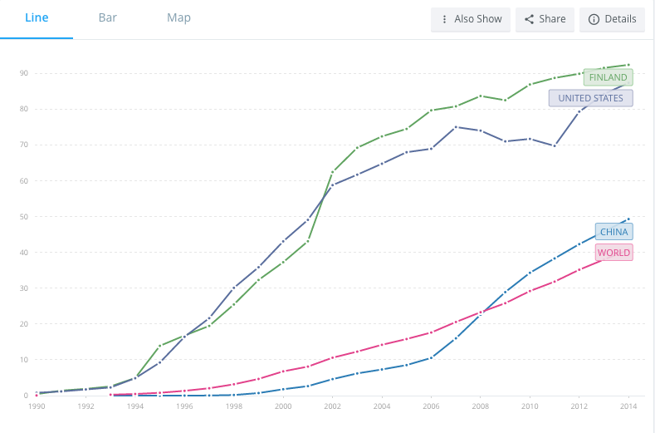
Internet Users/100 people Data from Worldbank.org

Slide 33
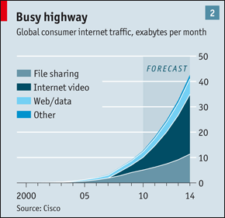
Economist (Sept 4, 2010) “Future of the Internet”

Slide 34
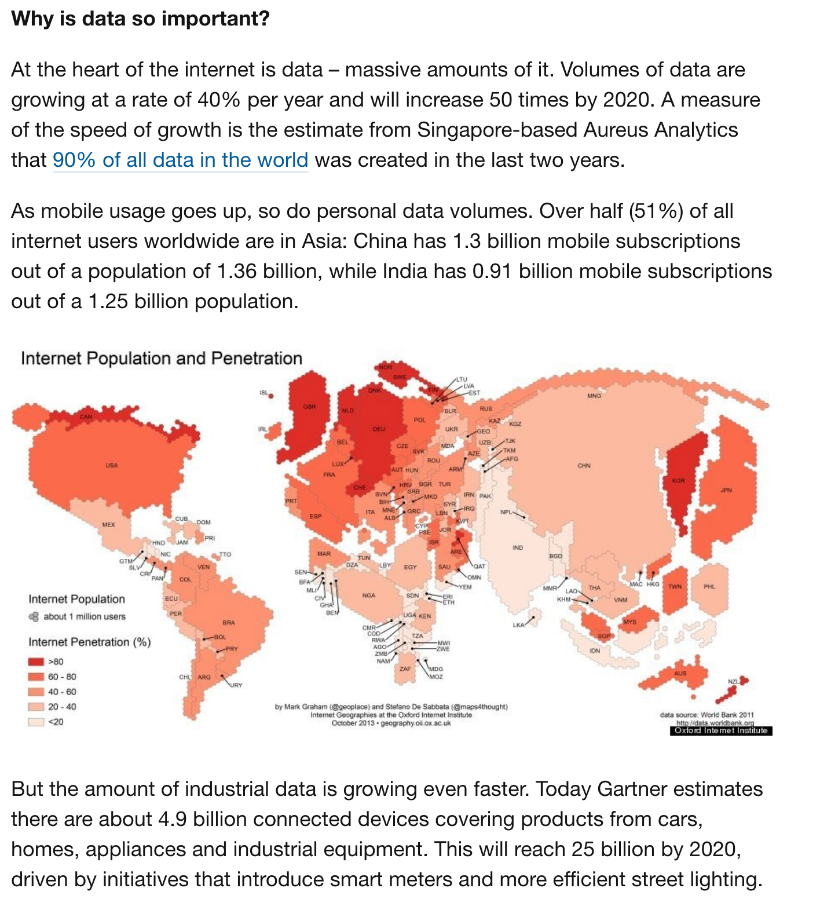
The 4th Industrial Revolution
Notes:
The Fourth Indistrial Revolution: https://www.weforum.org/agenda/2016/01/the-fourth-industrial-revolution-what-it-means-and-how-to-respond
“The First Industrial Revolution used water and steam power to mechanize production. The Second used electric power to create mass production. The Third used electronics and information technology to automate production. Now a Fourth Industrial Revolution is building on the Third, the digital revolution that has been occurring since the middle of the last century. It is characterized by a fusion of technologies that is blurring the lines between the physical, digital, and biological spheres”
https://www.weforum.org/agenda/2016/01/what-is-the-future-of-the-internet/

Slide 35
Wide Area Networking In Class Exercise
Each Classroom Table is a Communications Company centered in various World Cities
Spread out among the 12 World Cities with 3 minimum and 4 maximum students per World City
Each Comm Company should design, purchase and build the “Physical” Layer Network interconnecting their Hub with those of other World Cities
Assume that all communications traffic from the entire country is aggregated at this World City for networking with other World Cities except for
USA: divide the Capital Budget and Traffic in half between New York and San Francisco
China: divide the Capital Budget and Traffic in half between Bejing and Hong Kong
Negotiate with other Comm Companies for Access to their Hub and Network

Slide 36
Wide Area Networking In Class Exercise
Podium
London UK
Astana Kazakh-stan
New York USA
Beijing China
Frankfurt Germany
Karachi Pakistan
San Francisco USA
Hong Kong
Lagos Nigeria
Mumbai India
Sao Paulo Brazil
Sydney Australia

Slide 37
Wide Area Networking In Class Exercise
The Capital Budget for each Country which you can spend today for capacity for the next 10 years for International Communication Infrastructure is 1% of the GDP of that Country for one year.
Assume that the installed cost of the Fiber Optic Cable and Electronics to provide 40 Gb/s (Gigabits/second) of bandwidth between two cities is $ 1 Billion/1000 miles. Round the distance between the cities to the nearest thousand miles except any distance less than 1000 miles is rounded up to 1000 miles. The installed cost of Ocean Cable and Terrestrial Cable per 1000 miles is the same, but the distances will be different.
Assume that the amount of communications traffic from one Country to one other Country is 40 Gb/s for each $ 5 Trillion of the sum of GDP of the two Countries.
Submit answers in “Global Network In-Class Exercise” in LMS

